Slide 1
Benchmarking
( 4,5)
CITYMAPPER
Why these?
Travel planners that can be used in Stockholm
+1mn downloads in Google Play Store
Mixed average ratings
( 3,5)
v
GOOGLE MAPS
( 2,2)
Pain points
Conventions
Positives
SL

Slide 2
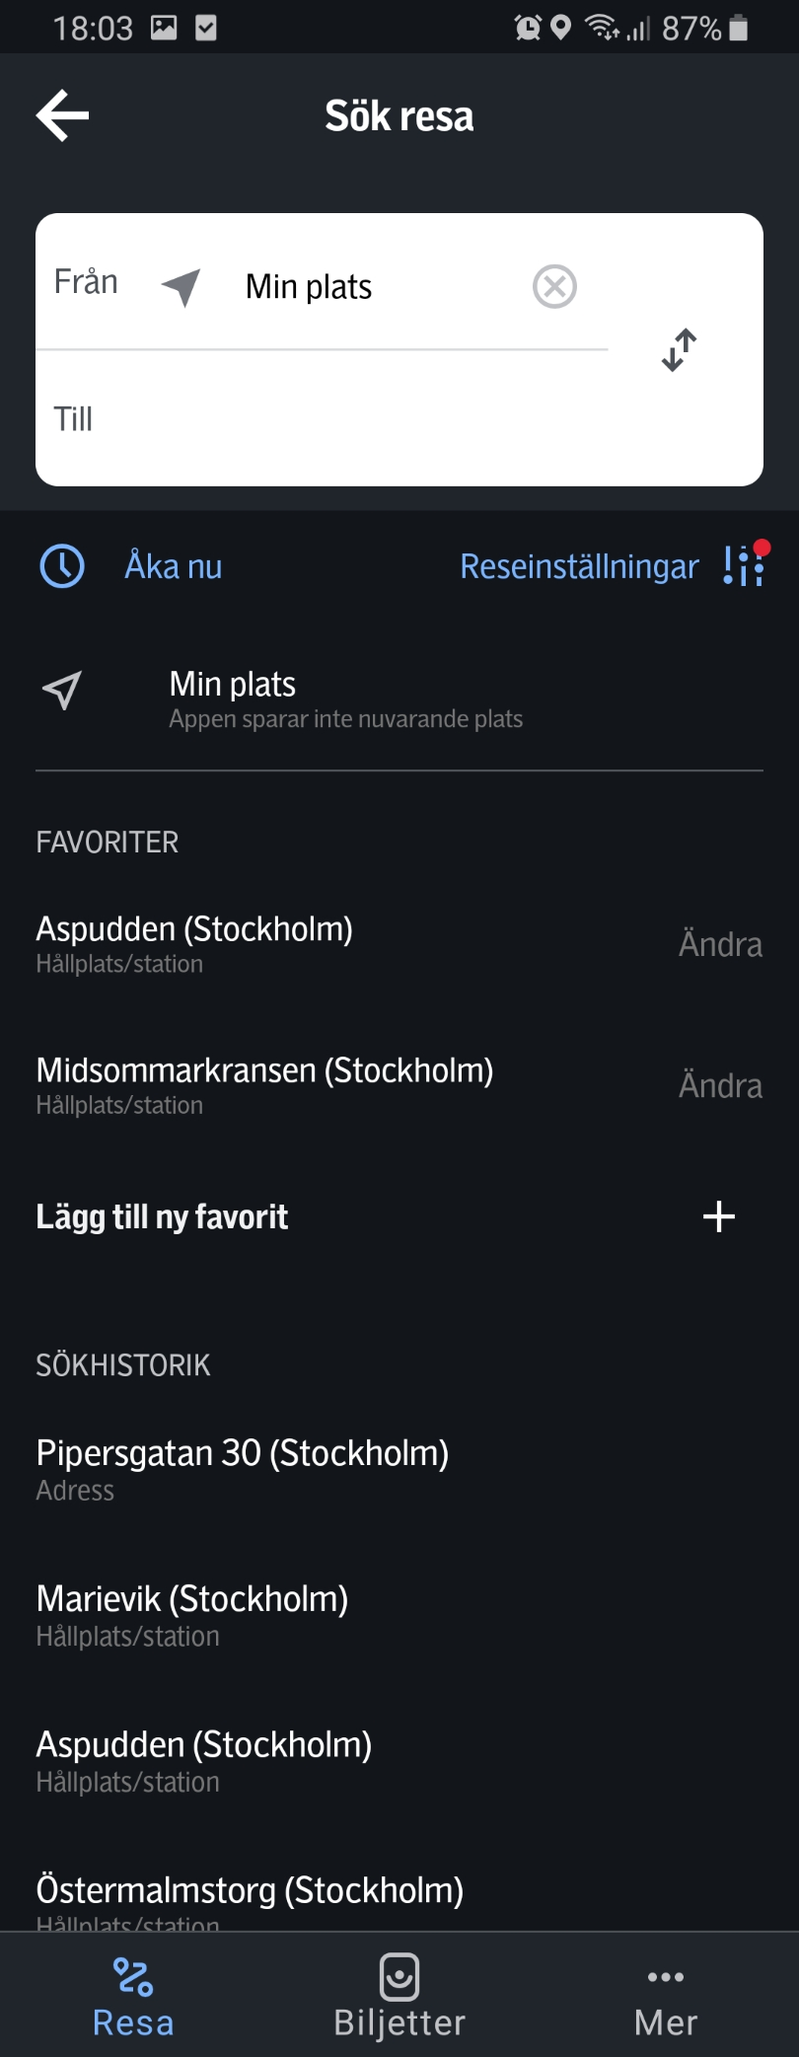
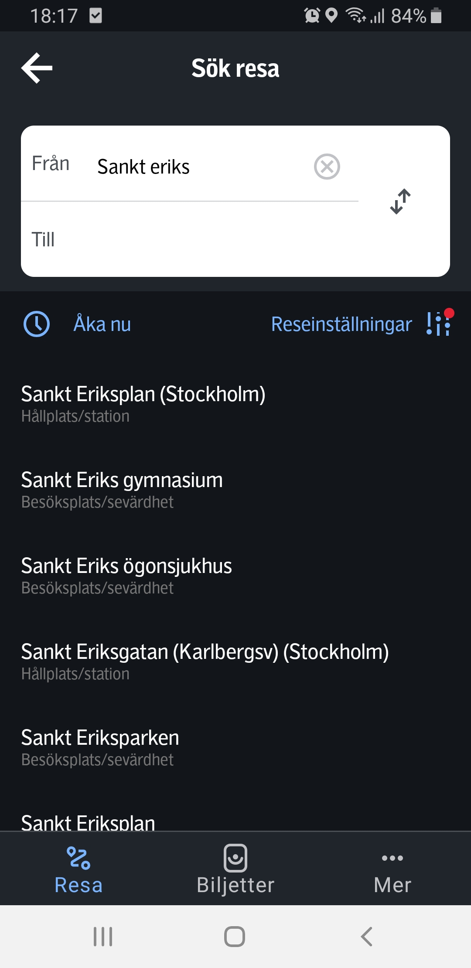
SL

Slide 3
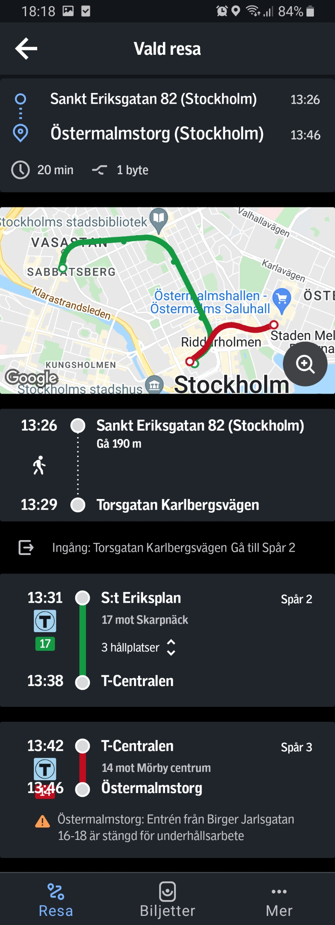
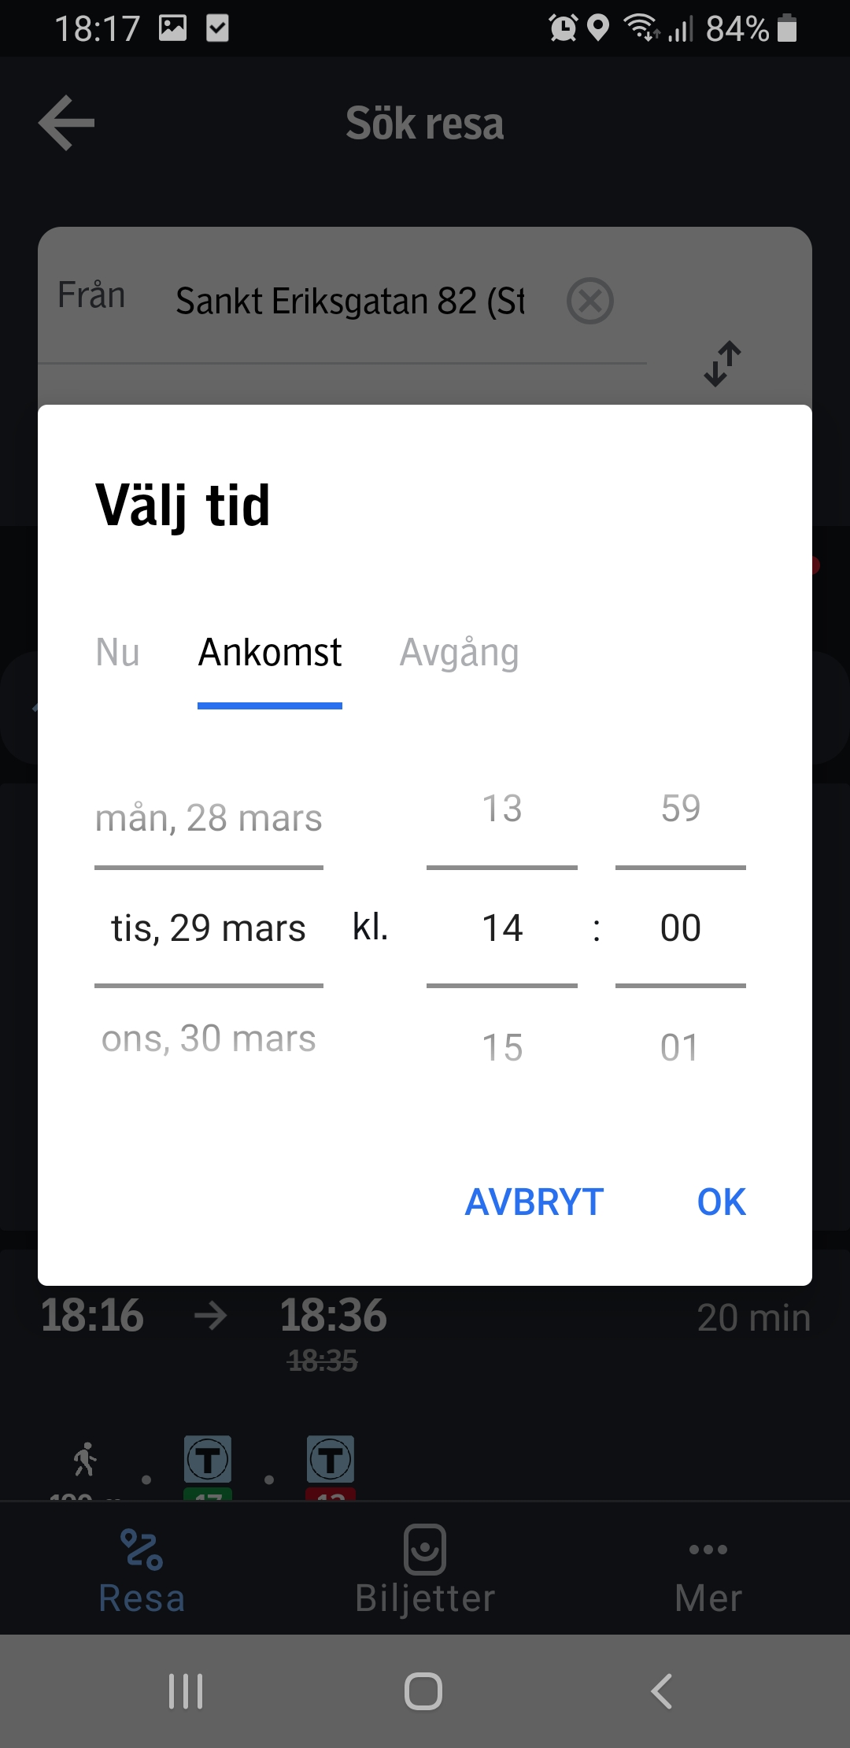
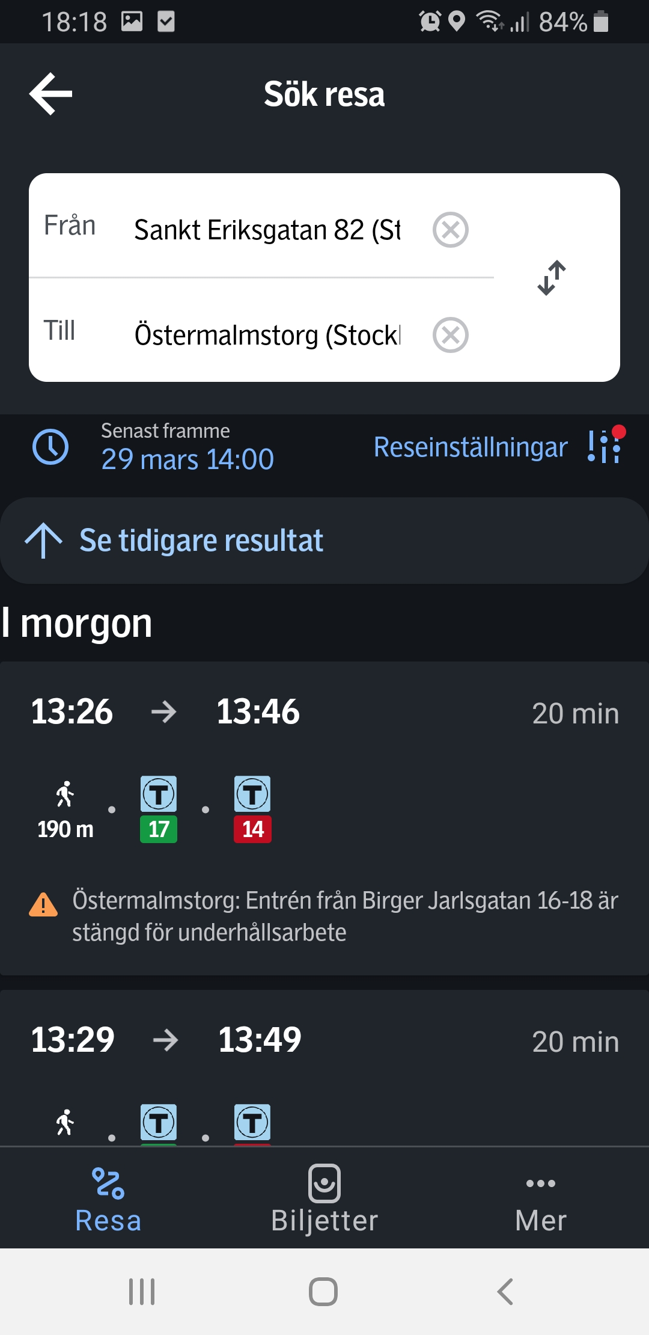
SL

Slide 4
SL
Map and search bar in homepage
Preset ”My position” as starting point, connected to GPS
The trip mapped out
Metro station symbol
Easy to reach search bar with right thumb
Settings and time settings easy to see because of the colour
Fast way of reaching favourites and search history
Can see which time settings are made
Can easily see time, way of transportation, duration, times of changes
Overview of duration and number of stops
Coloured line is a good visualization of the metro line
Tells you how many stations to go
Favourites and search history blends together too much
Clock picker takes times to scroll with
The overview mistaken for part of the detailed view

Slide 5
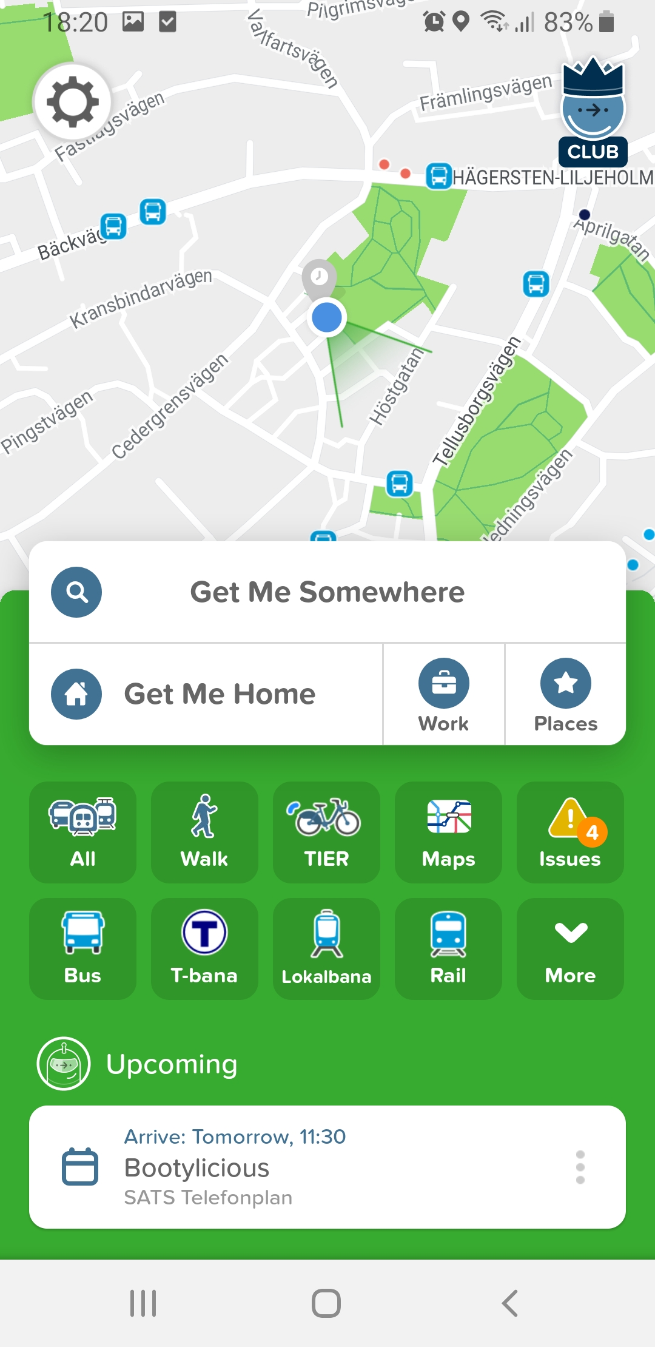
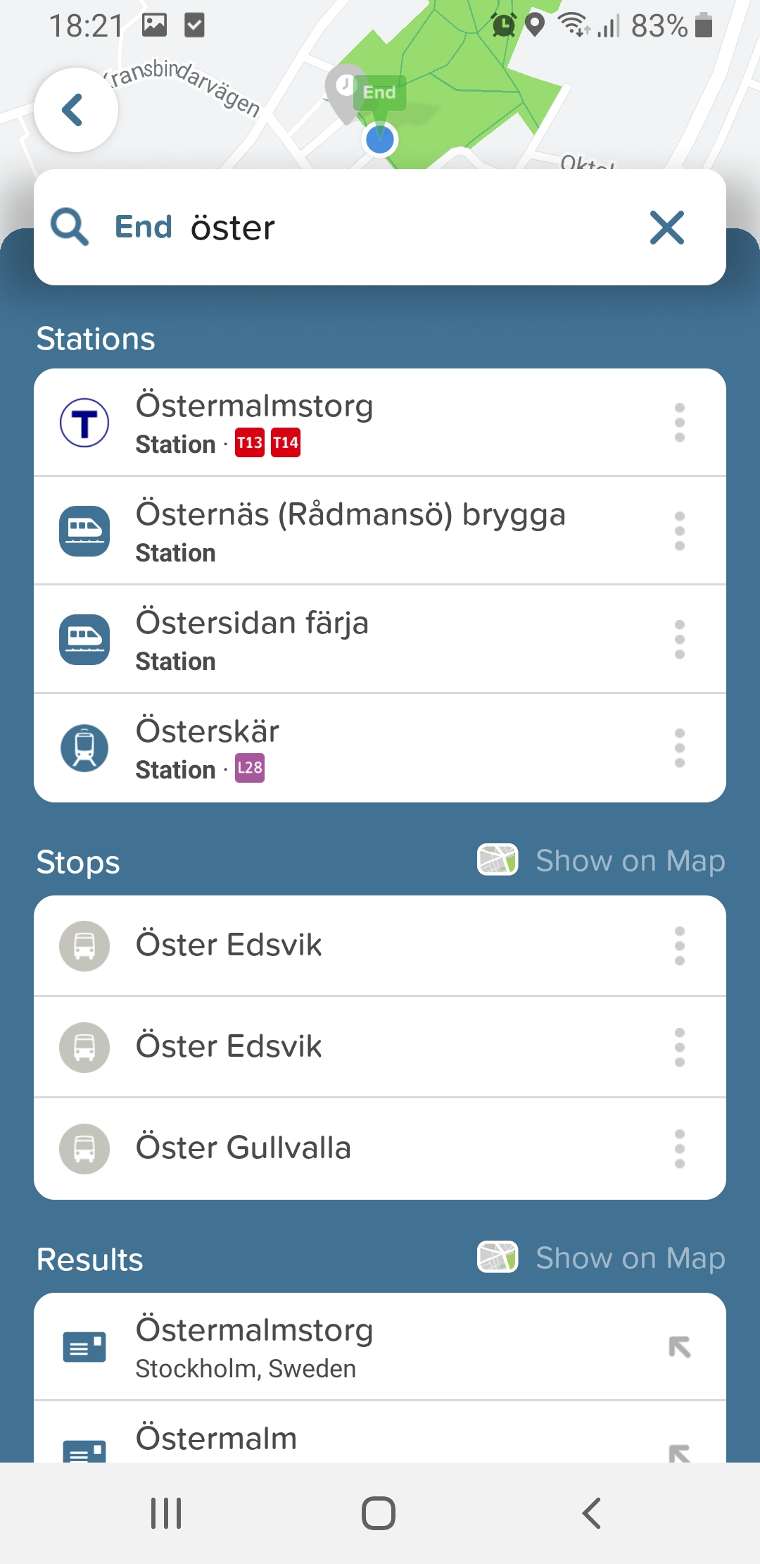
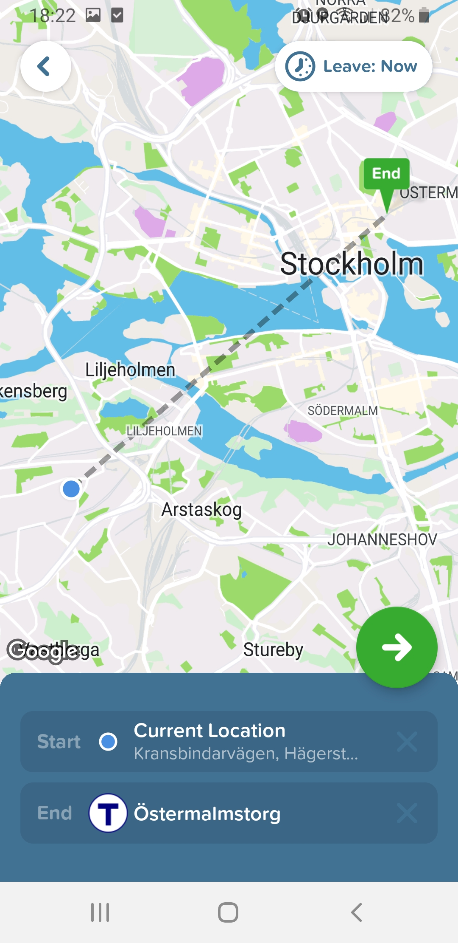
CITYMAPPER
v

Slide 6
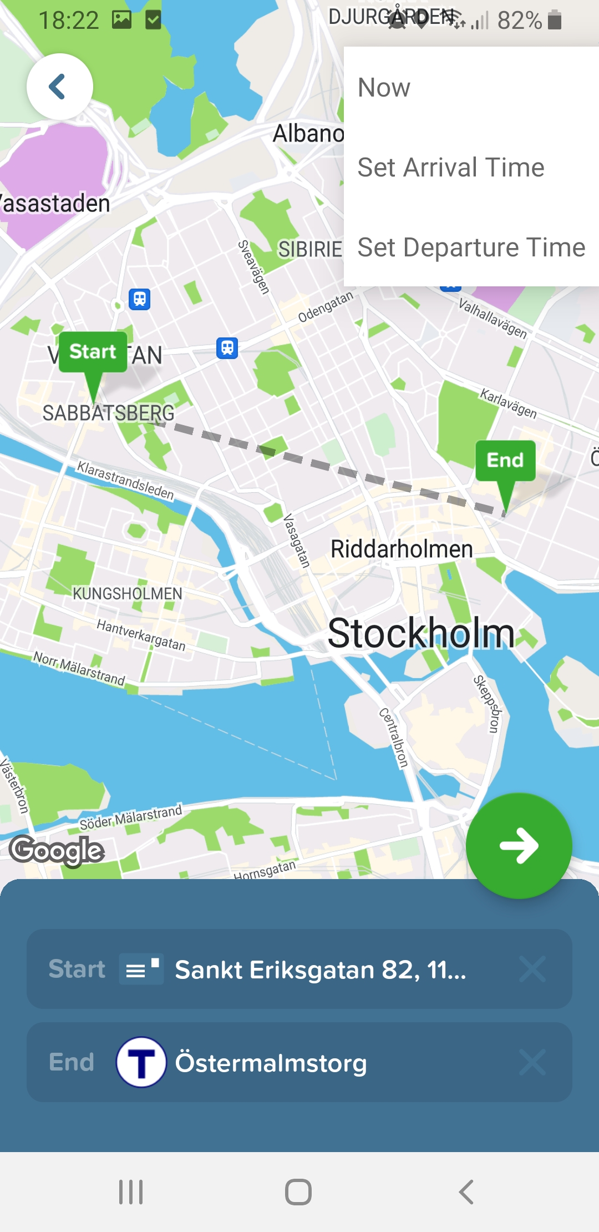
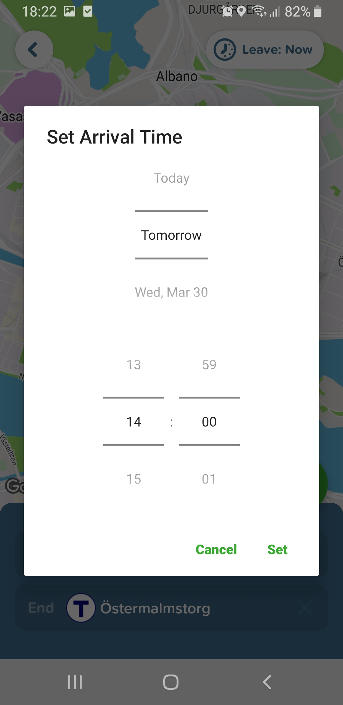
CITYMAPPER

Slide 7
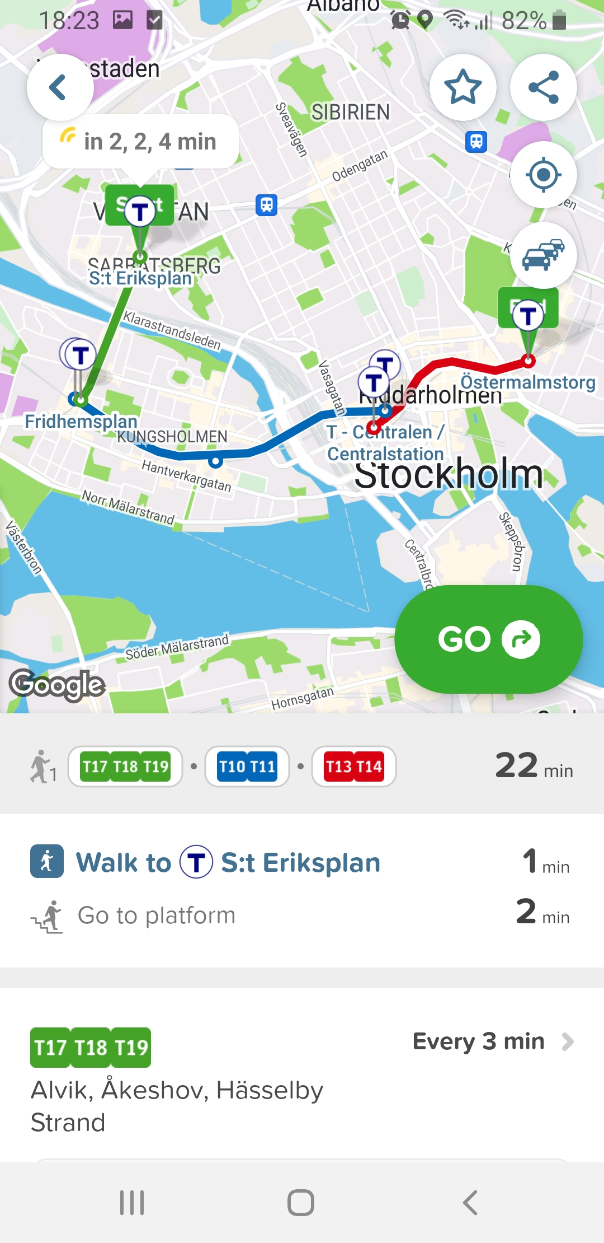
CITYMAPPER

Slide 8
CITYMAPPER
Map and search bar in homepage
Preset ”My position” as starting point, connected to GPS
The trip mapped out
Metro station symbol
Easy to plan trip for upcoming event, connected to calendar
Can see difference between stations and stops/addresses
Clear overview that shows number of stops, duration and types of transportation
Clear and non-cluttered visualization of travel with metro line
Cluttered homepage and non understandable why the buttons are needed
Time settings blend into the map
Extra click for making time settings
Clock picker takes times to scroll with
Confusing what the symbols do
Live time confused with duration between stops

Slide 9
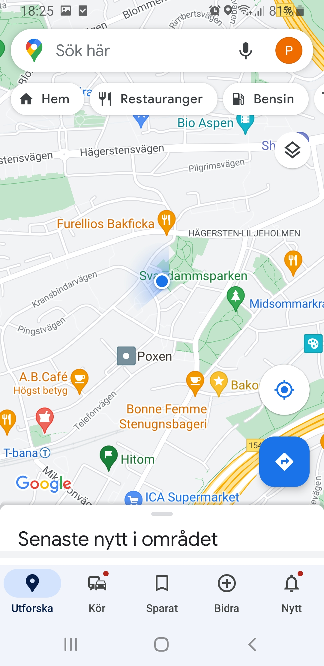
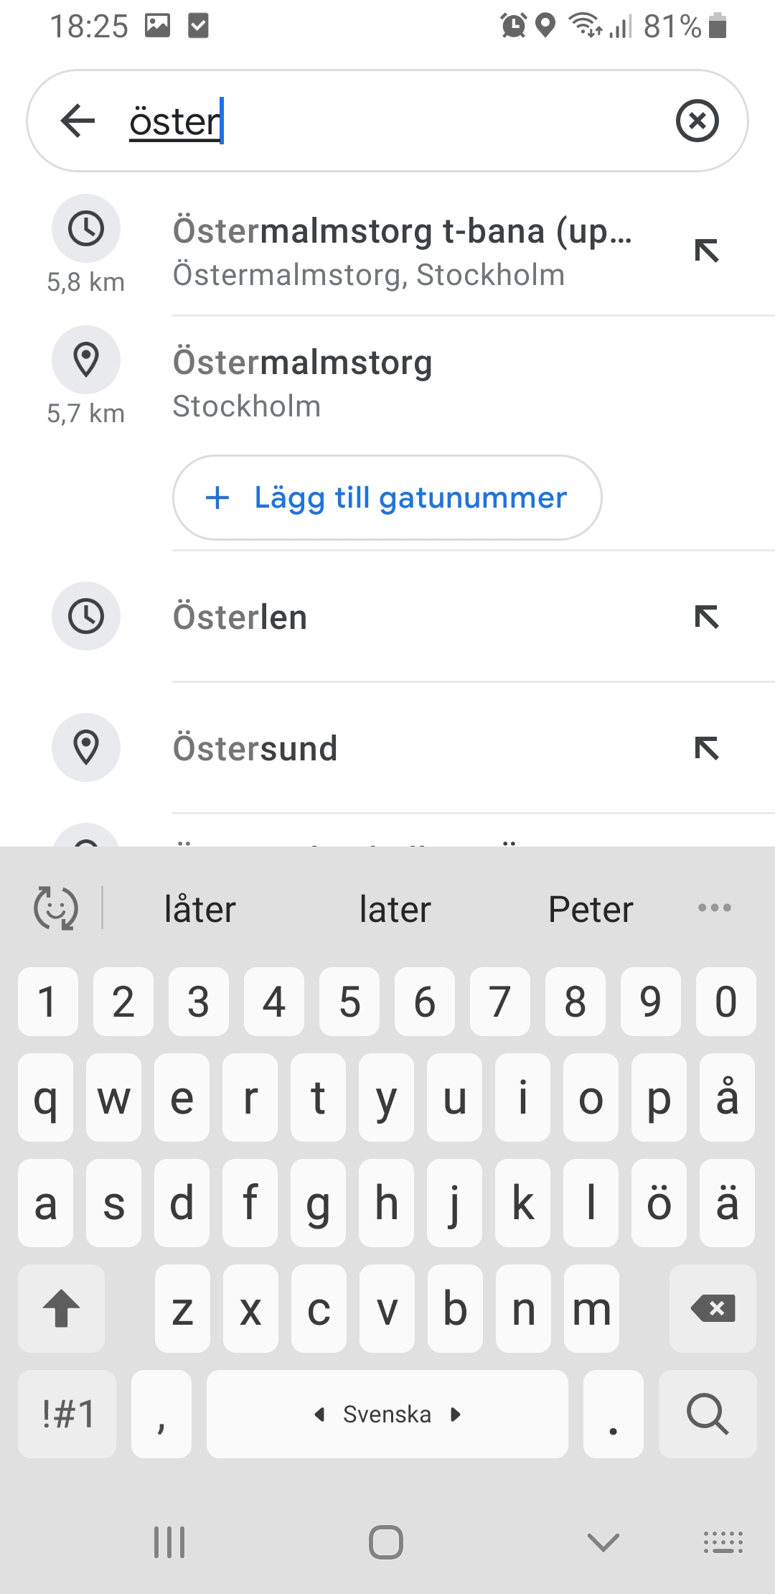
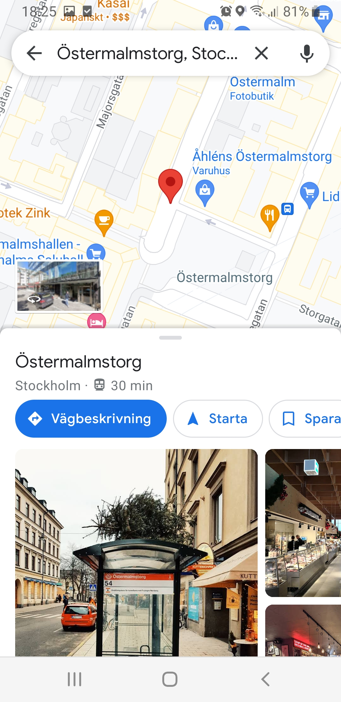
GOOGLE MAPS

Slide 10
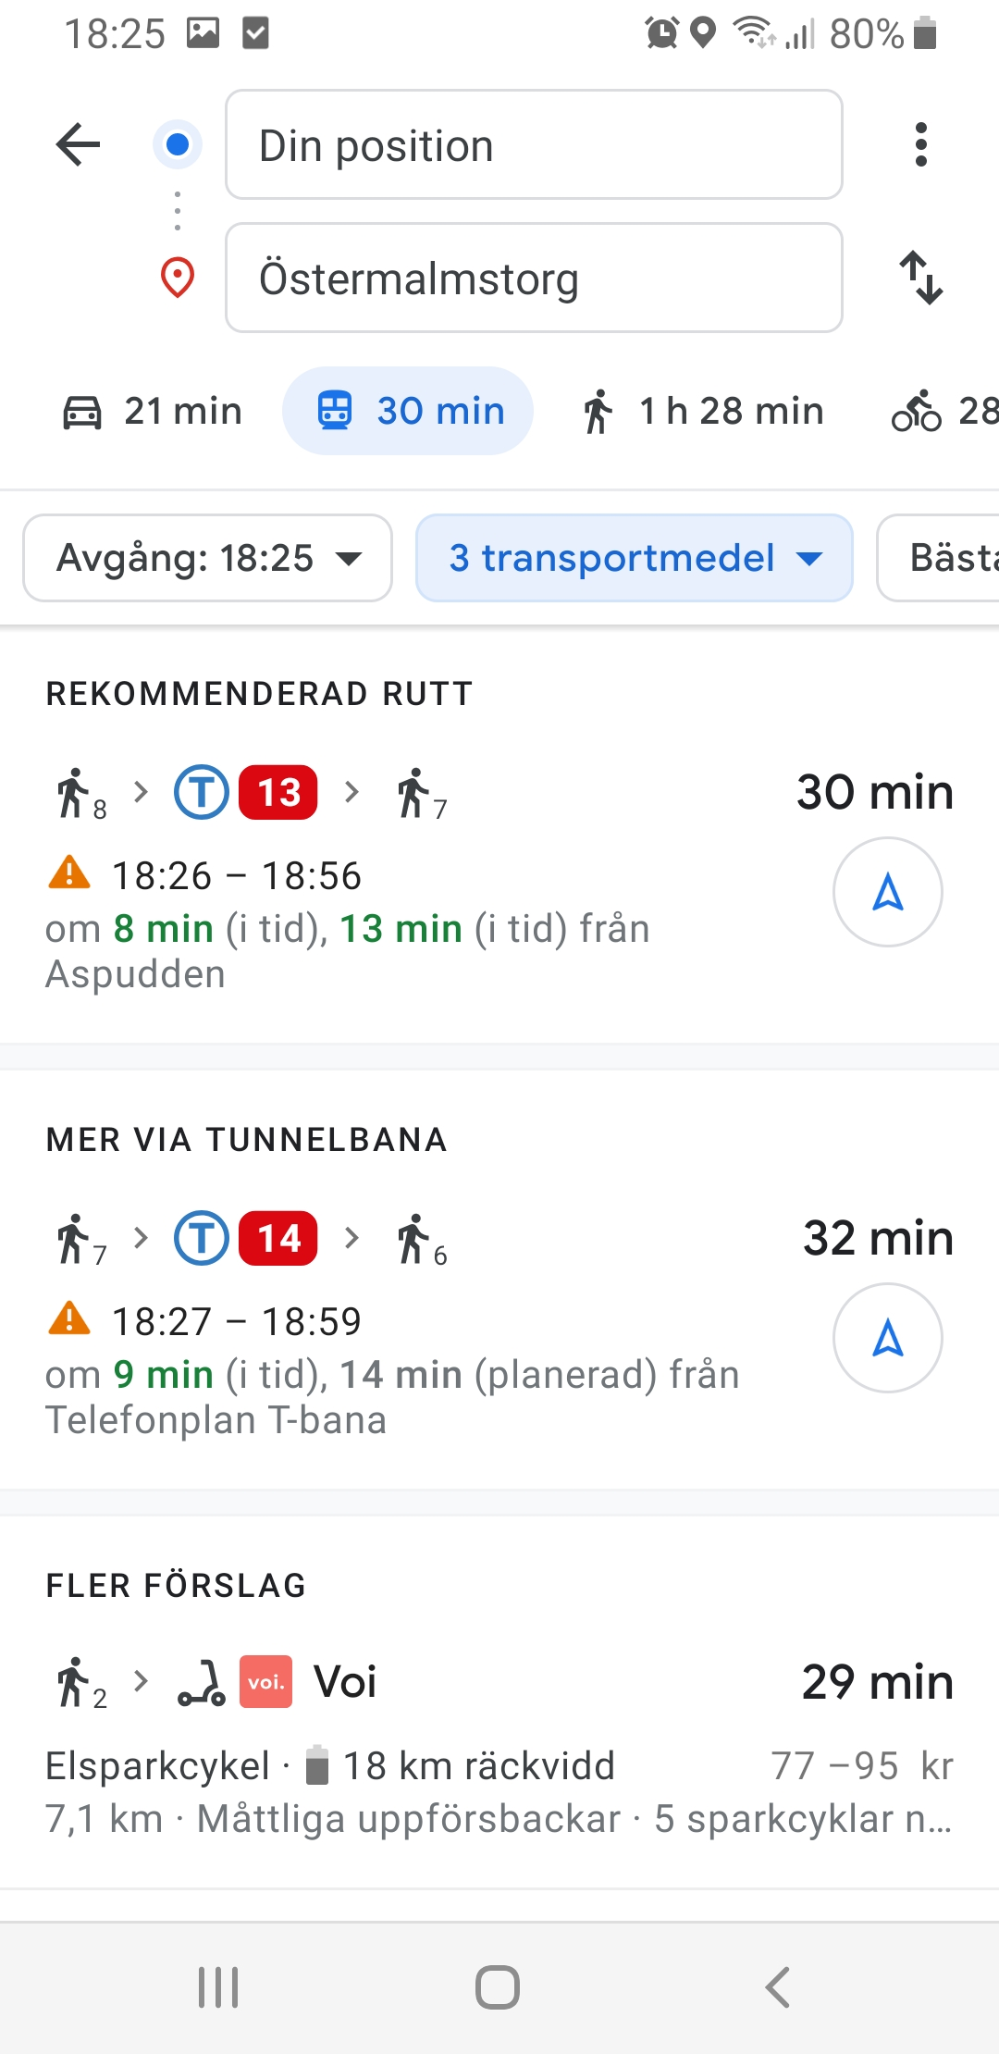
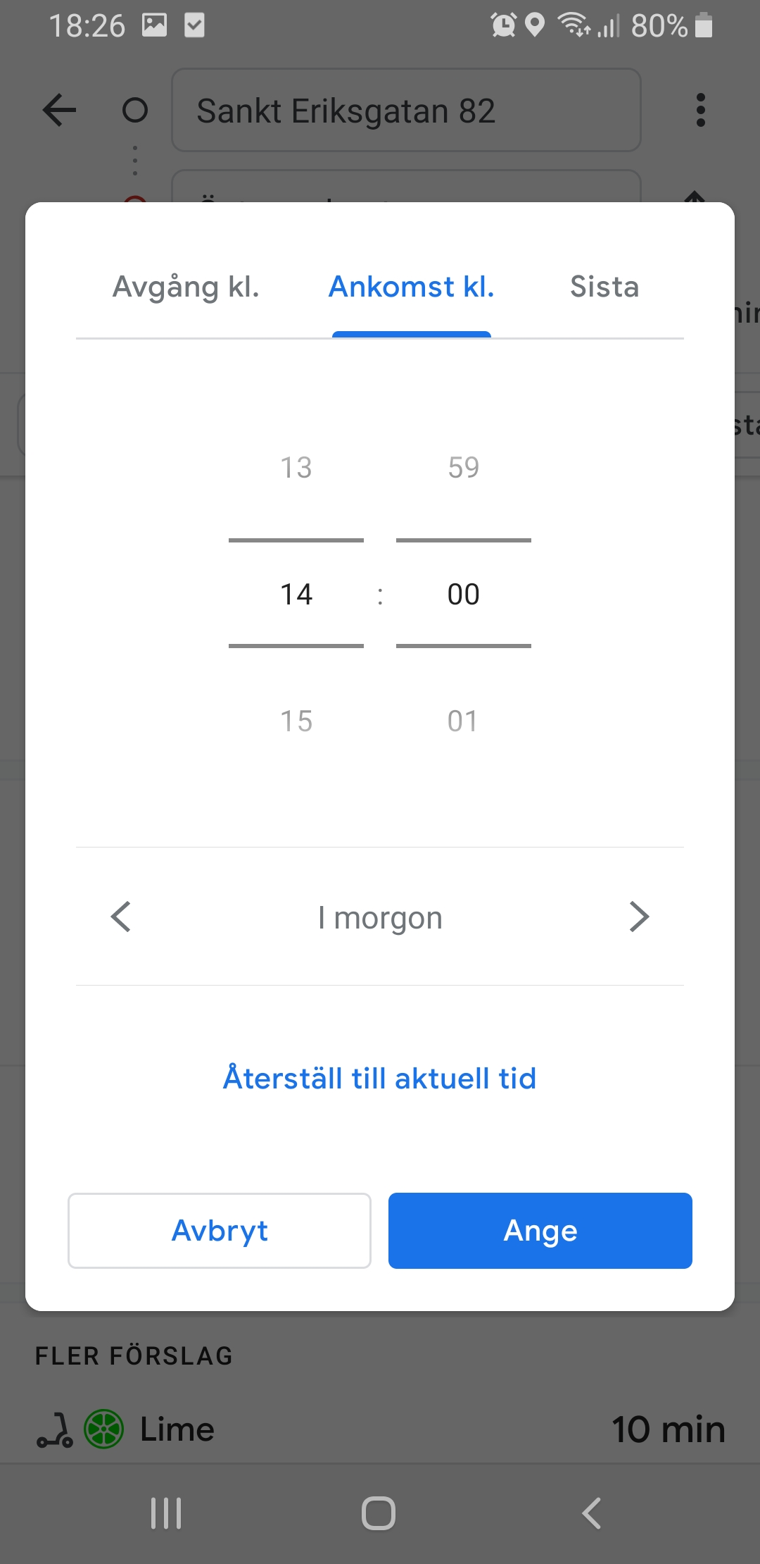
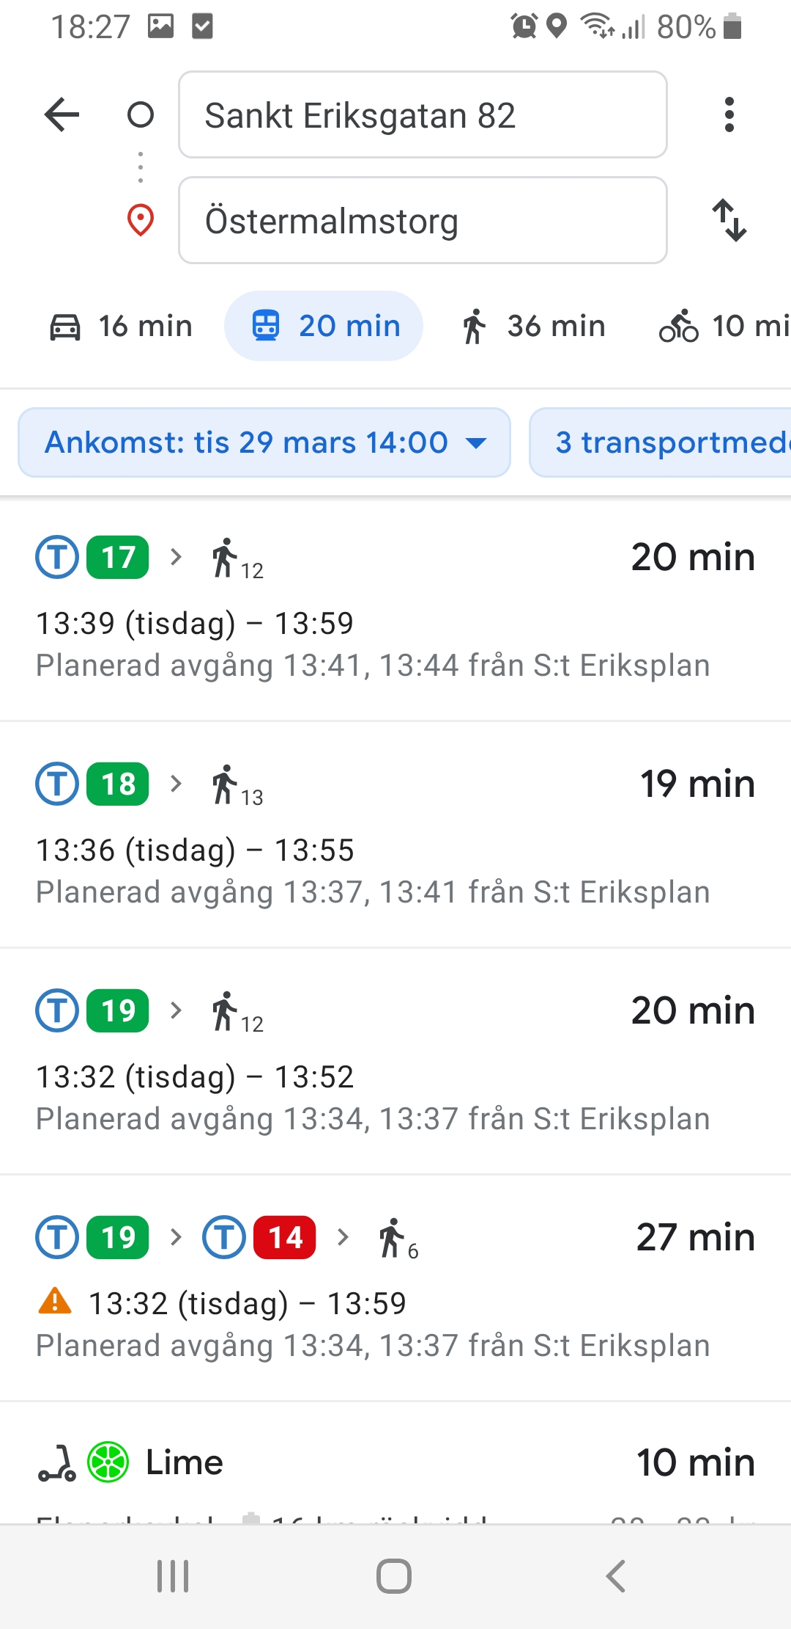
GOOGLE MAPS

Slide 11
GOOGLE MAPS

Slide 12
GOOGLE MAPS
Map and search bar in homepage
Preset ”My position” as starting point, connected to GPS
Switch button
Metro station symbol
Can easily see time, way of transportation, duration, times of changes
Count down to next departure
Can see which time settings are made
Overview of number of stops and ways of transportation
Coloured line is a good visualization of the metro line
Clock picker takes times to scroll with

